Slide 1
Positioning
Principles of Marketing
Notes:
All text in these slides is taken from https://courses.lumenlearning.com/waymakerintromarketingxmasterfall2016/, where it is published under one or more open licenses.
All images in these slides are attributed in the notes of the slide on which they appear and licensed as indicated.
Cover Image: No title Authored by: Nicolai Berntsen Located at: https://unsplash.com/photos/F3uyey6ours License: Creative Commons Zero

Slide 2
Positioning
Positioning is a strategic process that marketers use to determine the place or “niche” an offering should occupy in a given market, relative to other customer alternatives
When you position a product or service, you need to understand
Place
Rank
Attitude
Outcomes

Slide 3
Differentiation
To make a product or service stand out from its competitors in ways that provide unique value to the customer
Identifies a set of characteristics and benefits that make a product different and better for a target audience that:
Customers value when they are evaluating choices
Competitors cannot easily copy
Notes:
Macy's Flower Show. Authored by: Stephen Rees. Located at: https://www.flickr.com/photos/stephen_rees/4499802916/. License: CC BY-NC-ND: Attribution-NonCommercial-NoDerivatives

Slide 4
Positioning vs. Differentiation
Name | Positioning | Differentiators
Wal-Mart | Wide selection of products people want, at the lowest prices | Wide selection; low prices
Target | Trendy, fashionable products at reasonable prices | Continually refreshed, on-trend product selection
Macy’s | Preferred “go-to” shopping destination for upscale brands and current fashions. | Broad selection of most-wanted, upscale brands; engaging shopping experience
Notes:
Revision and Adaptation. Authored by: Lumen Learning. License: CC BY: Attribution

Slide 5
Steps of the Positioning Process
Confirm your understanding of market dynamics
Identify your competitive advantages
Choose competitive advantages that define your market “niche”
Define your positioning strategy
Communicate and deliver on the positioning strategy
Notes:
Lightbulbs. Provided by: Pixabay. Located at: https://pixabay.com/en/light-bulbs-light-bulb-light-energy-1125016/. License: CC0: No Rights Reserved

Slide 6
Step 1: Confirm Your Understanding of Market Dynamics
A firm understanding of your target market and answers to the following questions:
In which product, service, or market category (also called the “frame of reference”) do you plan to use this positioning?
Which target segment is your focus for the positioning you are developing?
What factors do these buyers evaluate when they make a purchasing decision?
How do these buyers view your competitors in the category?

Slide 7
Step 2: Identify Your Competitive Advantages
A trait, quality, or capability that allows you to outperform the competition
Gives your product, service, or brand an advantage over others in purchasing decisions
Comes from any or all of the following:
Price
Features
Benefits

Slide 8
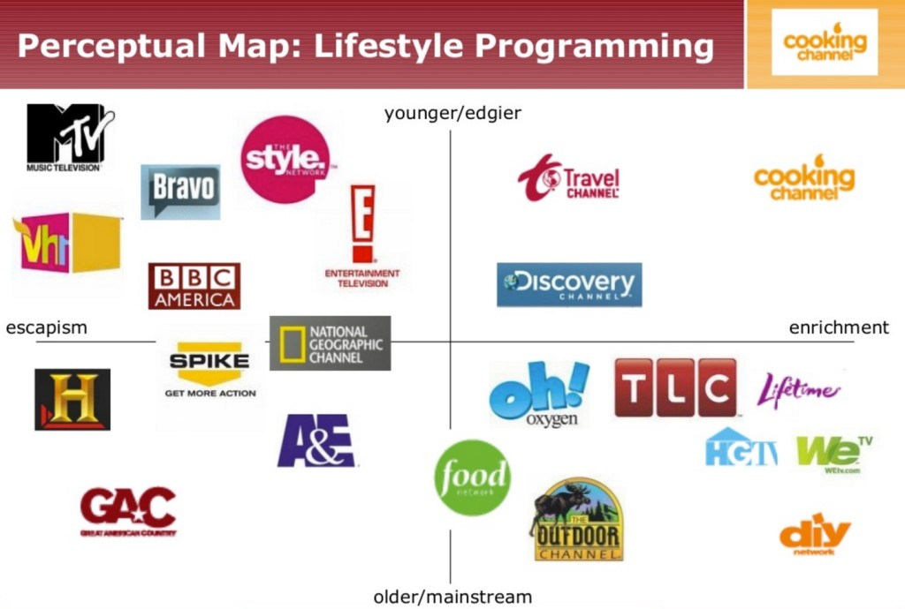
Step 3: Choose Competitive Advantages That Define Your Niche
Notes:
Screenshot Perceptual Map: Lifestyle Programming. Provided by: Lumen Learning. License: CC BY: Attribution
Source: Cooking Channel Marketing Project, http://www.slideshare.net/JenniferHoffmann/cooking-channel-marketing-project, Slide #60

Slide 9
Common Positioning Strategies
Differentiator | Positioning Strategy | Examples
Category Benefit | Position yourself as “owning” an important benefit and delivering it better than anyone else | Volvo = Safety Hallmark = Caring shared Hawaii = Aloha spirit
Best fit for the Customer | Position yourself as an ideal fit for the customer’s personality, style, and approach | Red Bull = Extreme Guess Jeans = Sexy chic Virgin Atlantic = Ultra cool fun
Business Approach | Position yourself with a distinctive approach to doing business | Jimmy John’s = Unbelievably fast TurboTax = Easy DIY
Anti-Competition | Position yourself as a preferred alternative to the competition | Apple = Think different Seven-Up = The Uncola
Price | Position yourself according to pricing: lowest cost, best value for the money, luxury or premium | Wal-Mart = Lowest prices Old Navy = Affordable fashion
Quality | Position yourself according to a quality standard: high quality or else reliably good quality at a reasonable price | Hearts on Fire = Perfection Ritz Carlton = luxury
Notes:
Provided by: Lumen Learning. License: CC BY: Attribution

Slide 10
Positioning Statement
One sentence that concisely identifies the target market and what you want customers to think about your brand Includes:
the target market
the brand name
the key points of differentiation
the product/service category
why customers should believe the positioning claims
Notes:
Kia GT4 Stinger. Authored by: Chad Horwedel. Located at: https://www.flickr.com/photos/chorwedel/12613017214/. License: CC BY-NC-ND: Attribution-NonCommercial-NoDerivatives

Slide 11
Formula for Positioning Statement
To [target audience], Product X is the only [category or frame of reference] that [points of differentiation/benefits delivered] because [reasons to believe].

Slide 12
Criteria to Evaluate Positioning Statements
Is it tailored to the target market?
Is it simple, focused, and memorable?
Does it provide an unmistakable picture of your product, service, or brand?
Can you deliver on the promise you make?
Does it provide helpful direction for designing the marketing mix and other decisions?
Notes:
Wieden+Kennedy door. Authored by: Sebastian Oehme. Located at: https://www.flickr.com/photos/iamseb/1581319503. License: CC BY-SA: Attribution-ShareAlike

Slide 13
Repositioning
Notes:
Compass Study. Authored by: Calsidyrose. Located at: https://www.flickr.com/photos/calsidyrose/4925267732/. License: CC BY: Attribution

Slide 14
Reasons to Consider Repositioning
Competition
New competitors entering or leaving the market; competitors joining forces
Competitor’s innovation that threatens to make your offering obsolete; competitive pricing strategies
Market environment
Economic slow-down or recovery
Changes in consumer confidence, the political climate, or social forces like the movement around social responsibility and sustainability

Slide 15
More Reasons to Consider Repositioning
Consumer trends
Changing tastes and preferences
Evolving attitudes and behaviors
New segments emerging as targets
Internal environment
Changes in organizational leadership and strategy
Acquisition or development of new technology
Introduction of innovation that offers new competitive advantages and differentiators

Slide 16
Repositioning and Market Perceptions
The repositioning process evaluates the established position of a product, service, or brand and focuses on how to alter the positioning–and, with positioning, market perceptions–in order to improve competitiveness
Notes:
Suitcases Stacked to the Ceiling. Authored by: Laura Gilmore. Located at: https://www.flickr.com/photos/genbug/3529776320/. License: CC BY-NC-ND: Attribution-NonCommercial-NoDerivatives

Slide 17
Pitfalls of Repositioning
Insufficient research
A bridge too far: If brands go too far in a new direction, customers may no longer believe the claims
Underestimating “back to basics”
Overpromising
Confusing positioning

Slide 18
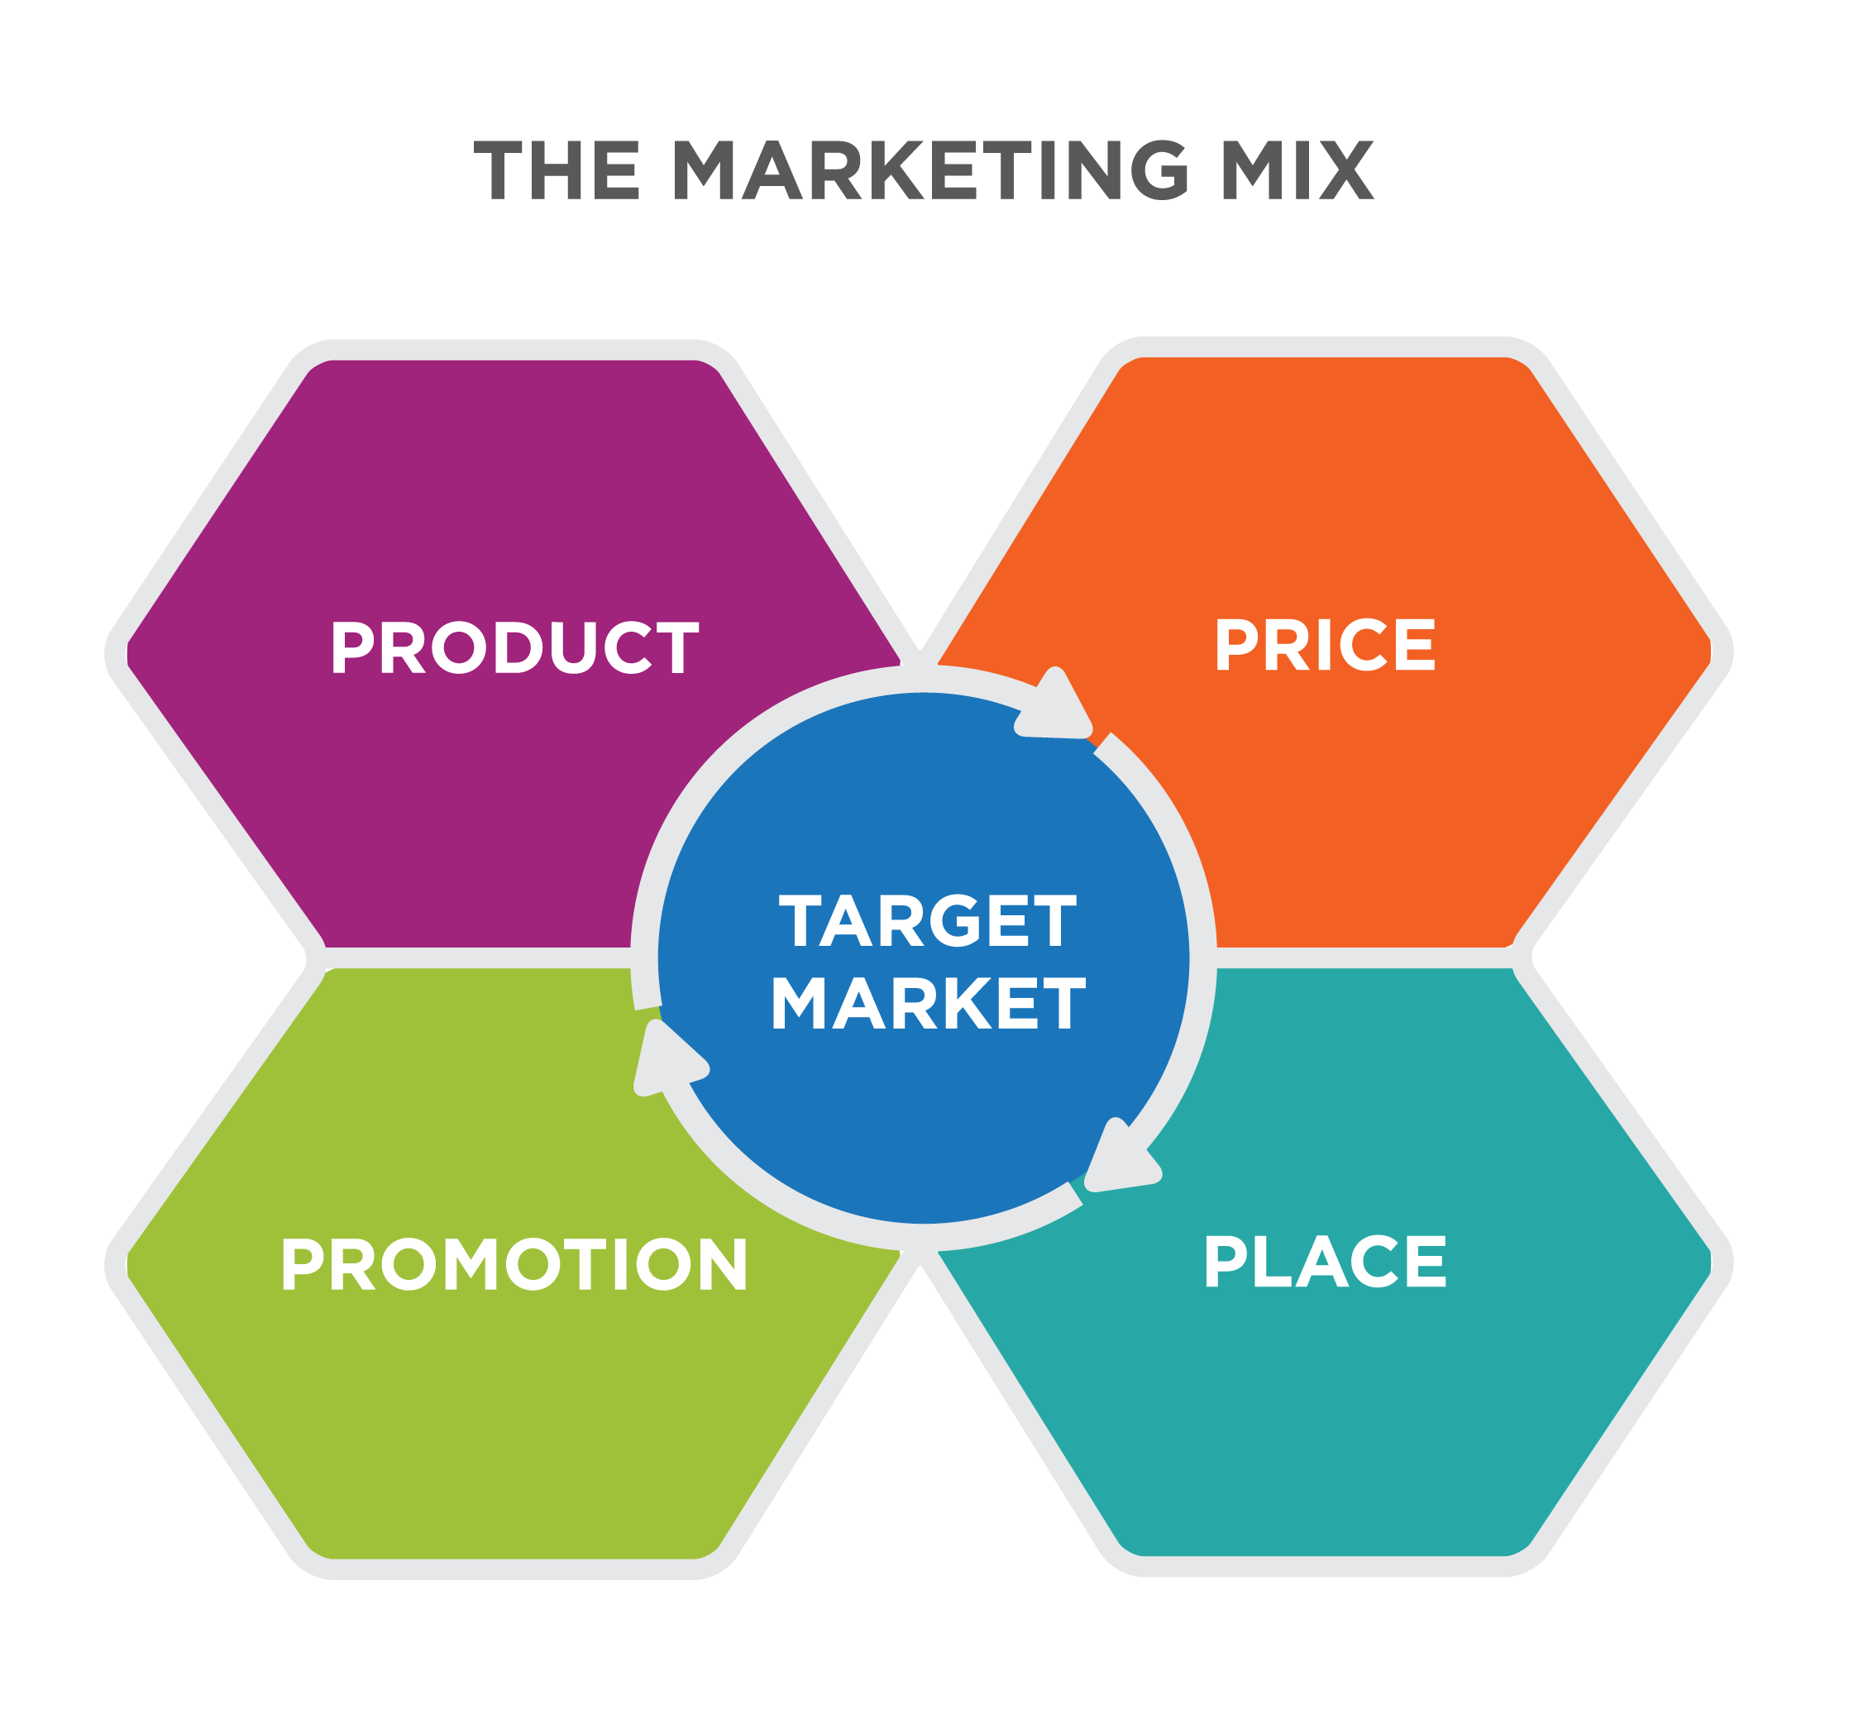
Implementing a Positioning Strategy
How can each part of the marketing mix fulfill the positioning statement?
Notes:
Implementing Positioning Strategy. Authored by: Lumen Learning. License: CC BY: Attribution

Slide 19
Product
Is your product, service, or brand capable of delivering everything your positioning statement claims?
Are any competitors doing it better than you?
How should you adjust your offering to ensure that it lives up to the promises?

Slide 20
Price
When it comes to pricing, how are you positioning your offering relative to competitors?
If pricing is part of your positioning strategy, is your offering well aligned with the price you’re asking customers to pay?
What pricing strategies should you consider in order to compete more effectively?

Slide 21
Place
Are any distribution-related themes like convenience or availability part of your positioning strategy or competitive advantage?
If so, what are you doing to ensure that you can live up to what you promise?
How are you communicating your new positioning approach to distribution and channel partners, and how does it impact them?

Slide 22
Promotions
How are you translating your positioning strategy into communications with your target audiences?
What behavioral shift are you trying to create as you launch your new positioning?
What types of campaigns will you use to introduce the new positioning?
Which communication tools will be most effective at reaching target audiences?
What are you doing to coordinate marketing messages and activities across different channels?

Slide 23
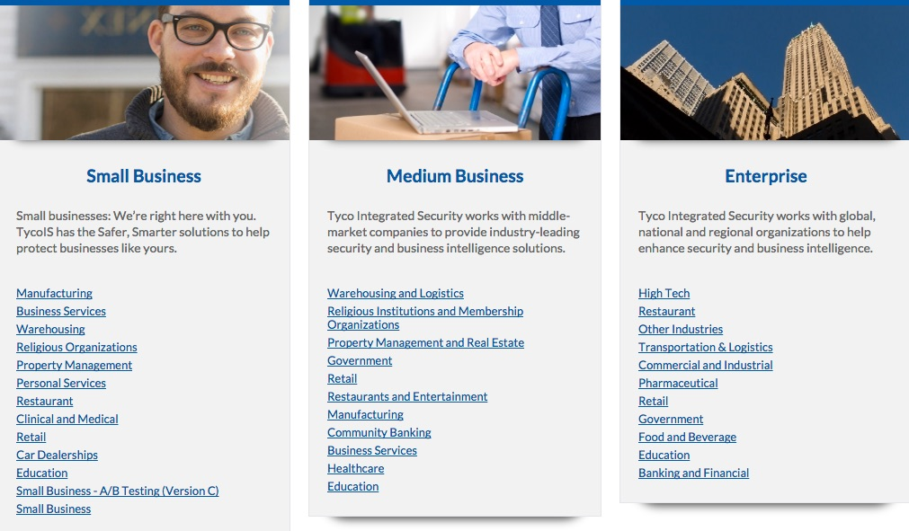
Example
Notes:
Screenshot of Tyco Solutions by Industry. Provided by: Lumen Learning. License: CC BY: Attribution

Slide 24
Measuring Implementation
Sales/revenue
Number of new/returning customers
Average spending per transaction
Brand/product awareness or perceptions
Favorability toward product/service/brand
New leads or inquiries from inside and outside your target segments
Web site traffic or social media “buzz”
Media attention
Customer Satisfaction
Return on investment for marketing campaigns and other activities

Slide 25
Practice Questions
What is the difference between a feature and a benefit?
Notes:
A feature is a quality of the product. A benefit is how it affects the consumer. Air bags are a feature. Feeling safe is a benefit.

Slide 26
Quick Review
What are positioning and differentiation, and why are they important to marketing a product or service?
What is the process of selecting a positioning and differentiation strategy?
How do marketers develop and evaluate positioning statements based on defined criteria?
How do marketers reposition products or services? What are the associated risks and complexities?
What is the process of implementing a positioning strategy?

